Slide 1
Selected Networking Concepts
Lessons for Module D.4

Slide 2
Table of Contents
Some Basic Concepts
Web Servers & Web Pages
Domain Names & IP Addresses
Mail Servers & Other Types of Servers
Network Routing & ISPs
Local Area & Wide Area Networks & VPNs

Slide 3
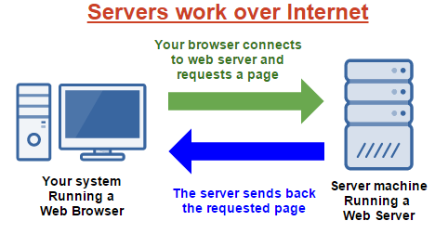


2) Some Basic Concepts
Section Topics
Client Server Model
Peer-To-Peer Model
Hyperlinks
Packets & Data
Firewalls
Basic Concepts
Home

Slide 4
2.1) Client Server Model
Explain the Client Server Model
What is the Client
What is the Server
Provide an example of an application that uses the Client Server Model
Basic Concepts
Home

Slide 5
2.2) Peer-To-Peer Model
Explain the Peer-To-Peer Model
What is a Peer
How is it different from a Client Server Model
Provide an example of an application that uses the Peer-To-Peer Model
Basic Concepts
Home

Slide 6
2.3) Hyperlinks
What is a Hyperlink?
How are Hyperlink related to Web Pages?
How are Hyperlinks related to this PowerPoint document?
Basic Concepts
Home

Slide 7
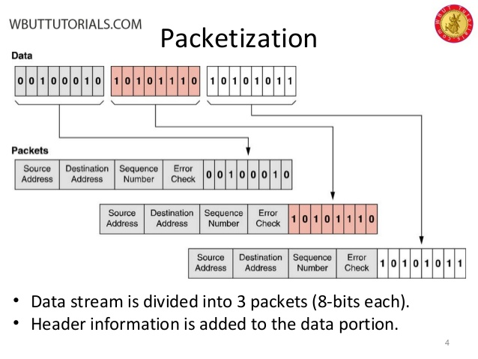
2.4) Packets & Data
In order to send a large file across the internet it must be broken into smaller fragments.
These small fragments are called “Packets”
In the example, the data file is split into 3 packets.
Basic Concepts
Home

Slide 8
2.4) Packets & Data
In order to send a large file across the internet it must be broken into smaller fragments.
These small fragments are called “Packets”
In the example, the data file is split into 3 packets.
Basic Concepts
Home

Slide 9
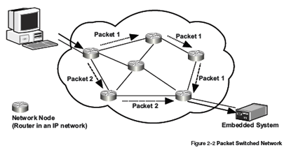
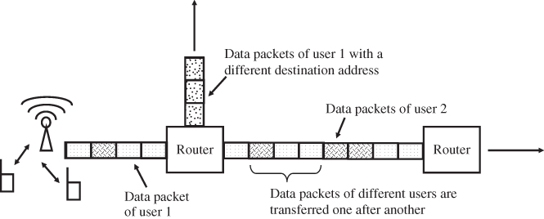
2.4) Packets & Data
What happens to a message (or data) when it is sent across the Internet?
Basic Concepts
Home

Slide 10
2.4) Packets & Data
What happens to a message (or data) when it is sent across the Internet?
Basic Concepts
Home

Slide 11
2.4) Packets & Data
What happens to a message (or data) when it is sent across the Internet?
Basic Concepts
Home

Slide 12
2.5) Firewalls
What is a Firewall?
How does a Firewall protect your computer?
How does a Firewall protect remote servers?
Basic Concepts
Home

Slide 13
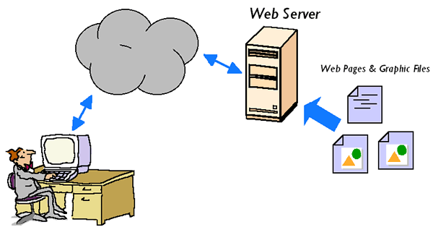

3) Web Servers & Web Pages
Section Topics
HTML
Browsing A Web Page
Web Client Hardware & Software
Web Server Hardware & Software
Web Servers
Home

Slide 14
3.1) HTML & Web Pages
What does HTML stand for?
How is HTML related to Web Pages?
What are some examples of HTML tags used in Web Pages?
What are some other languages used in Web Pages?
Web Servers
Home

Slide 15
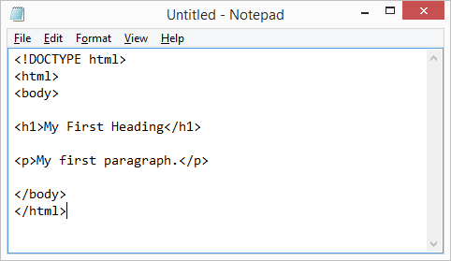
3.1) HTML & Web Pages
What does HTML stand for?
Hyper Text Markup Language
HTLM is the basic language used to write Web pages.
HTPM defines “tags” that can be used to format text, import images, and organize page content.
HTML files (Web Pages) are just text files
Web Servers
Home

Slide 16
3.2) Browsing a Web Page
What happens when you browse a web page?
What are the main steps?
Web Servers
Home

Slide 17
3.4) Web Client Hardware & Software
What does a Web Browser do?
What are some common web browsers?
How are they different?
What are some other types of Web Clients?
Is there any special Hardware or Software required to run a web client?
Web Servers
Home

Slide 18
3.4) Web Server Hardware & Software
What does a Web Server do?
Where are Web Servers located in the Network / Internet?
What special Software is needed for a Web Server
What special Hardware is needed for a Web Server
Web Servers
Home

Slide 19


4) Domain Names & IP Addresses
Section Topics
What is a Domain Name?
What is an IP Address?
Controls the assignment of Names & Addresses?
Domain Names
Home

Slide 20
4.1) What is a Domain Name?
What is a Domain Name?
How are Domain Names related to Web Pages?
How does my computer find and use Domain Names?
Domain Names
Home

Slide 21
4.2) What is an IP Address?
What is an IP Address?
What is the difference between IPv4 and IPv6?
How does my computer convert a Domain Name to an IP Address?
Domain Names
Home

Slide 22
4.3) Who Controls Domain Names?
Who Owns and Controls Domain Names and IP Addresses?
How can I register a Domain Name for my own use?
Domain Names
Home

Slide 23


5) Mail & Other Servers
Section Topics
Mail Servers
File Servers
Database Servers
Other Types of Servers
Servers
Home

Slide 24
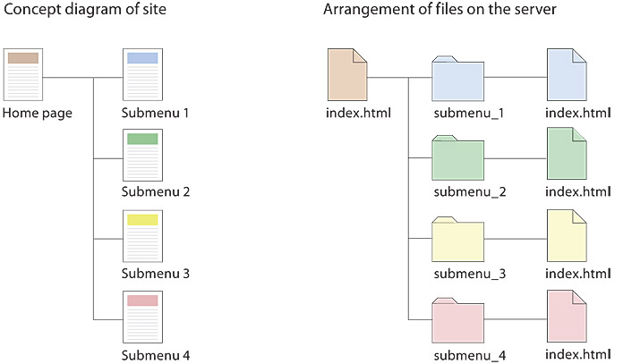
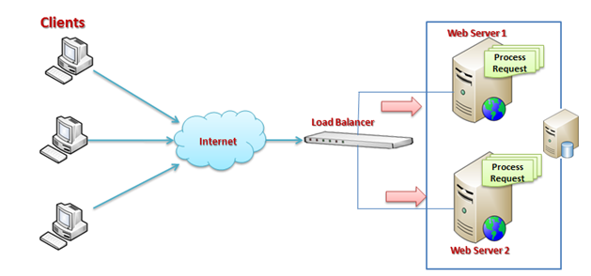
5a) Web Server
Protocol: HTTP / HTTPS
Responds to requests for web pages that have mostly fixed content
Uses files stored on disk
Does this as fast as possible
Large websites may use duplicated web servers
Specialized Software:
Apache (Linux)
IIS (Microsoft)
ASP (Active Server Pages)
Hardware Requirements:
Fast CPU
Fast Network Connections
High Reliability

Slide 25
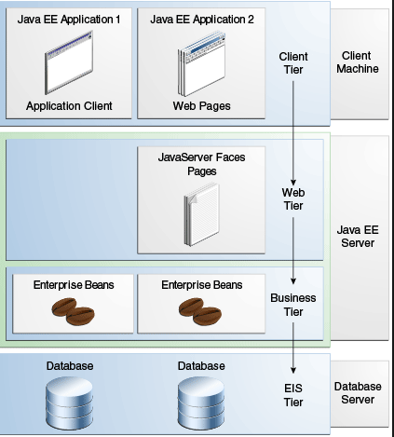
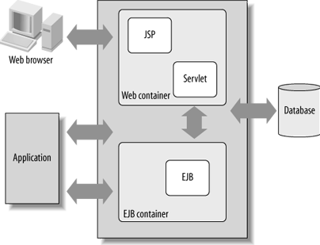
5b) Application Server
Web Browser
Internet Connection
Protocol: HTTP: or App Specific
Responds to requests for web pages that have dynamic (changing) content
Web pages are created “on the fly”
Web pages are a combination of text and programming
Also applies to web applications that don’t use web pages
Online Games
Apps with Custom PC Interface
Specialized Software:
Java Server Pages (JSP)
Enterprise Java Beans (EJB)
ASP (Active Server Pages)
Works in Parallel With:
Web Servers
Database Servers
Application Server
Internet Connection
Database Server

Slide 26
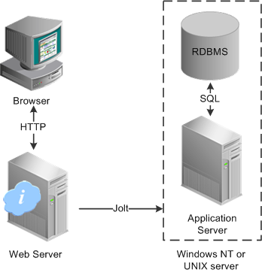
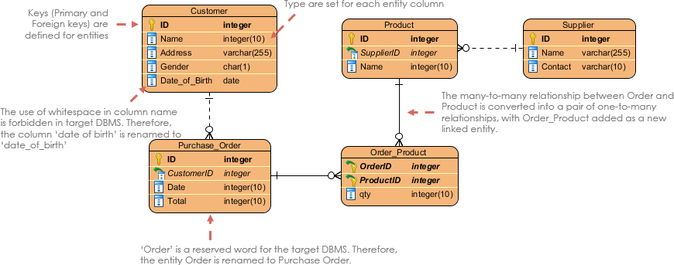
5c) Database Server
Database Definition
Stores data in “tables” in a database program rather than in “files” on a disk
Each Table stores a specific type of thing
E.g. Customers
E.g. Products
Other Tables store relationships between things
E.g. Purchases
E.g. Orders
Databases provide a way to store and manage dynamic data and changing relationships.
Specialized Software:
Supports SQL Database Language
MyQSL (Linux)
Oracle (Active Server Pages)
Works to Support:
Web Servers
Application Servers
Other Custom Applications

Slide 28
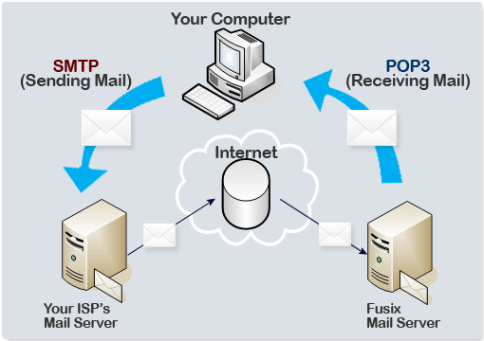
5d) Mail Server
Protocol: SMTP / POP3
Used when mail is downloaded and stored on your computer (e.g. Outlook)
Not used for Browser based mail (e.g. gmail)
Also used to send mail between servers on the Internet

Slide 29
5.1) Mail Servers
Downloaded Mail
What is SMTP / POP3?
What are some common Mail Clients
What are some advantages of downloaded mail?
Web Based Mail
What are some common Browser Based Mail Services
What are some advantages of browser based mail?
Mail Servers
Where is mail stored in the Internet?
How is mail delivered across the Internet?
What special Hardware & Software is required for a mail server?
Servers
Home

Slide 30
5.2) File Servers
Cloud Based Storage
What are some Cloud Storage Services (applications) ?
What are some advantages of cloud based storage over local storage?
File Servers
What special Hardware & Software is required for a file server?
Servers
Home

Slide 31
5.3) Database Servers
What is a Database?
What is SQL?
What type of information is stored in a database?
How are databases used and combined with web pages?
Database Servers
What are some common Database products?
What special Hardware & Software is required for a database server?
Servers
Home

Slide 32
5.4) Other Servers
Describe some other types of internet servers not covered by the slides above.
Servers
Home

Slide 33
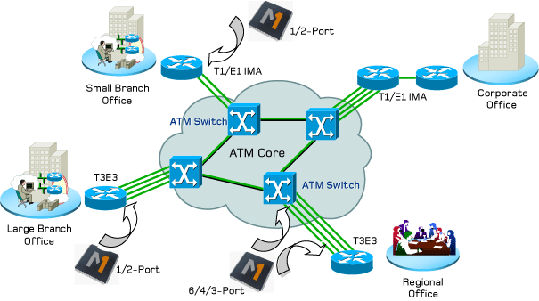

6) Network Routing & ISPs
Section Topics
Internet Service Provider (ISP)
Internet Connection Technologies
Network Routers & Switches
Networks
Home

Slide 34
6.1) Internet Service Providers (ISPs)
What is an ISP?
What are some common ISPs people use in the Toronto Area?
How is an ISP different from a Internet application / service?
Networks
Home

Slide 35
6.2) Internet Connection Technologies
Describe some internet connection technologies using telephone lines.
Describe some internet connection technologies using Wi-Fi.
Describe some internet connection technologies using fibre optics cables.
Networks
Home

Slide 36
6.3) Network Routers & Switches
What is a "Routing Table"?
How are data packets sent through the internet between a client and a server?
What special hardware & software is required for a network router / switch?
Networks
Home

Slide 37
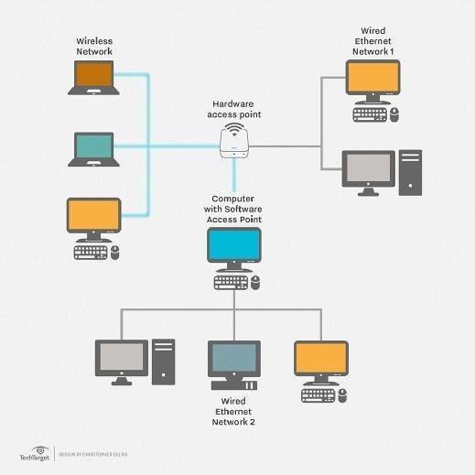
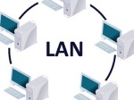
7) Types of Networks
Section Topics
Local Area Networks (LAN)
Wide Area Networks (WAN)
Virtual Private Networks (VPN)
LANs
Home

Slide 38
7.1) Local Area Networks (LAN)
What is a Local Area Network?
What is the purpose of a Local Area Network?
What types of applications, servers, and computers are connected to a LAN?
LANs
Home

Slide 39
7.2) Wide Area Networks (WAN)
What is a Wide Area Network?
What is the purpose of a Wide Area Network?
What types of applications, servers, and computers are connected to a WAN?
LANs
Home

Slide 40
7.3) Virtual Private Networks (VPN)
What is a Virtual Private Network?
How is a VPM different from a LAN / WAN?
How could you use a VPM to increase the security of services you use in the Internet?
LANs
Home

